Slide 1

Predictive maintenance system for network infrastructure
MUGISHA MICHAEL FRED Presentation

Slide 2

1. Problem Statement
Network infrastructure devices like routers, switches, and firewalls are prone to performance degradation and unexpected failures. This leads to significant downtime and maintenance costs. Predictive maintenance aims to forecast device performance metrics and identify potential failures in advance, enabling proactive measures to ensure network reliability.

Slide 3
2. Objective
Monitor Device Health: Continuously track key metrics such as CPU usage, memory usage, error counts, and network traffic.
Predict Potential Failures: Use machine learning models to forecast device performance and predict potential issues, such as high CPU utilization or increased error counts, before they lead to failures.
Classify Device Health Status: Categorize network devices into health states (e.g., “At Risk," “Critical," or “Healthy") to help network administrators prioritize maintenance tasks.
Support Proactive Maintenance: Provide actionable insights to prevent unexpected downtime by predicting future states of the devices based on historical and current data.
Optimize Resource Allocation: Enable efficient use of maintenance resources by focusing on devices most at risk of failure.

Slide 4
3. Description of the Dataset
Key Attributes:
Timestamp: Records the time of data capture.
Device: Type of network device (e.g., router, switch).
CPU (%): Device CPU utilization.
Memory (%): Memory usage as a percentage.
Errors (Count): Number of errors detected.
Traffic (Mbps): Network throughput in Mbps.
Current Status: Real-time device status (e.g., Normal, Overloaded).
System State: Indicates if the data is from "Current" or "Historical" periods.
Future State Prediction: Target variable for predictive maintenance tasks.
Detailed Dataset Analysis:
Numerical Data:
CPU (%):
Mean: 61.67%, ranging from 20.2% to 99.88%.
Indicates high variation in CPU usage.
Memory (%):
Mean: 60.19%, with a relatively narrow range (30%-89.87%).
Errors (Count):
Mean: 25, with a maximum of 50 errors.
Traffic (Mbps):
Mean: 269 Mbps, with traffic peaking at 499 Mbps.

Slide 5

3. Models Selected and Comparative Analysis
Three models were explored:
1. Linear Regression: Predicts continuous variables, simple but assumes linearity.
2. Vector Machine Classifier: Effective for non-linear data but computationally expensive.
3. Random Forest Classifier: Versatile, handles missing data well, but resource-intensive.

Slide 6
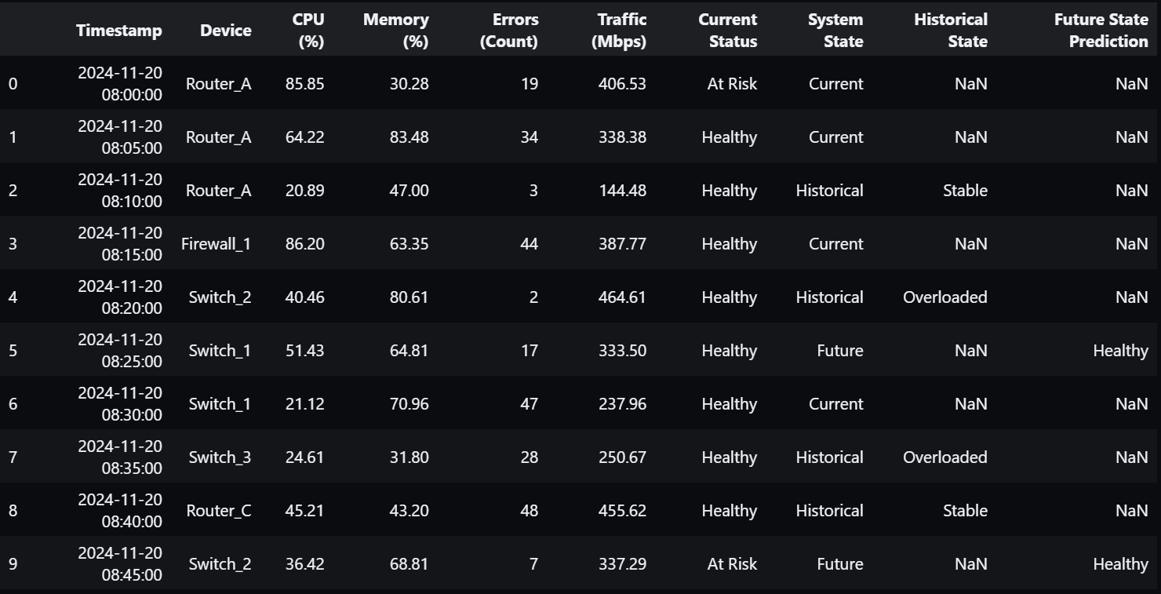
1. Linear Regression

Slide 7
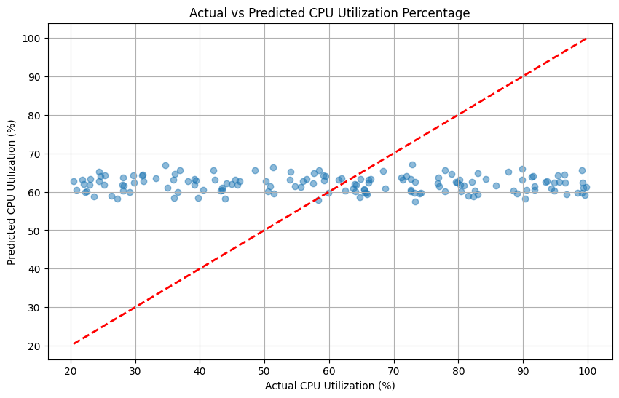
Actual vs Predicted CPU Utilization Percentage

Slide 8
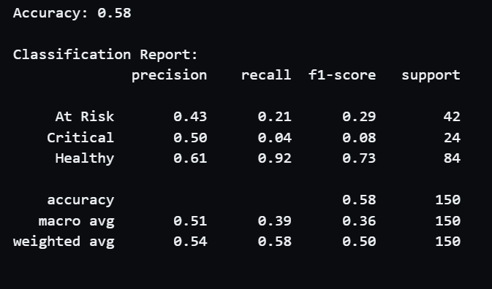
2. Vector Machine Classifier

Slide 9
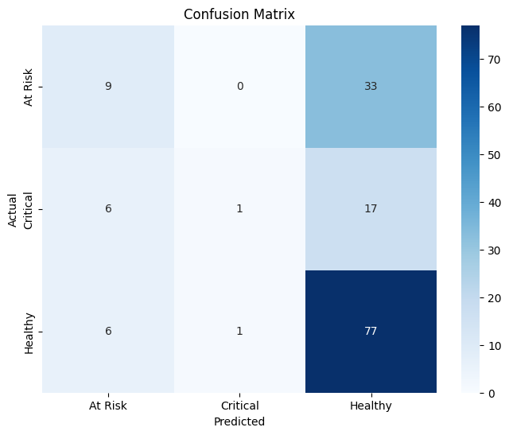
Confusion Matrix for VMC

Slide 10
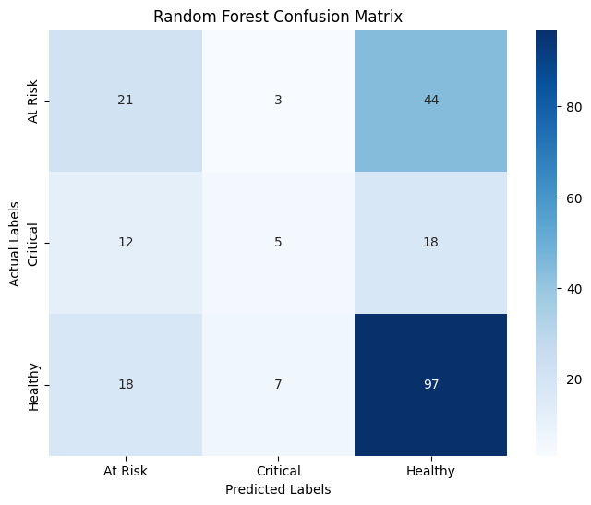
3. Random Forest Classifier

Slide 11
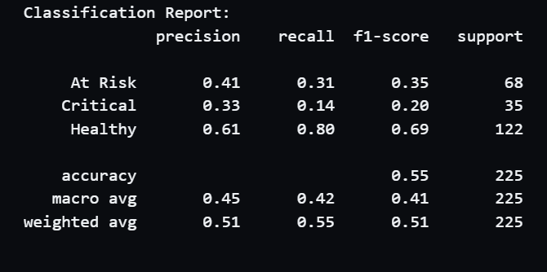
Classification Report for Random Forest

Slide 12
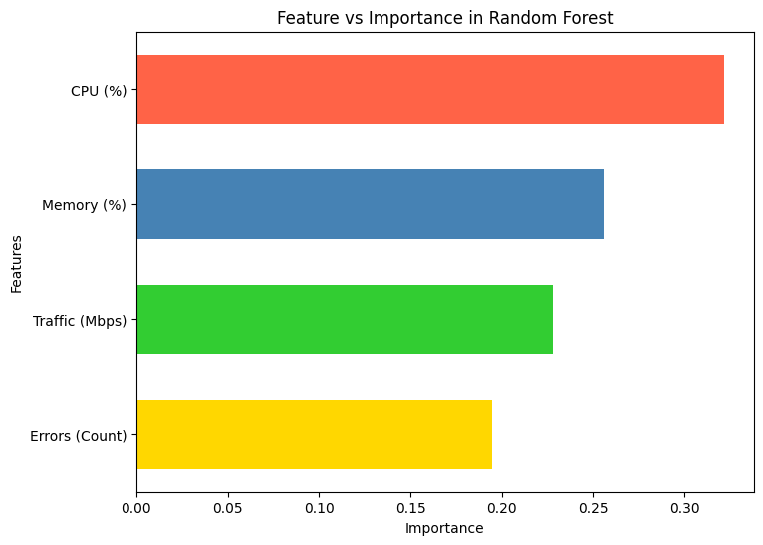
Feature vs Importance in Random Forest

Slide 13
The reason we choose the Random Forest Classifier
Handles Missing Data Well: Your dataset has missing values, and Random Forest can manage them better than most models.
Works for Both Tasks: It can handle classification (e.g., predicting device status) and regression (e.g., predicting CPU usage).
Combines Many Models: Random Forest uses multiple decision trees, making it more accurate and less likely to overfit.
Finds Important Features: It shows which data points (e.g., Traffic, Errors) are most important for predictions.
Handles Complex Data: Unlike Linear Regression, it works well with data that doesn’t have simple relationships.

Slide 14

4. Results and Discussion
Linear Regression: Accurate for normal operation but limited by non-linearity.
SVM Classifier: High classification accuracy but resource-heavy.
Random Forest Classifier: Ensemble nature offers stability and feature selection benefits.
Key Findings:
Prediction accuracy improves significantly when combining historical and real-time data.
Missing data poses challenges but can be mitigated through imputation strategies or model robustness.

Slide 15
5. Future Enhancements
Incorporate Advanced Models: Explore deep learning models (e.g., LSTM) for time-series forecasting.
Automated Feature Engineering: Use feature selection techniques to improve model efficiency.
Real-Time Monitoring: Deploy the system on a real-time data pipeline for live prediction and anomaly detection.
Scalability Improvements: Optimize algorithms for larger datasets using distributed computing frameworks like Spark.
Visualization Tools: Integrate interactive dashboards to visualize device trends and system health.

Slide 16
Conclusion
The Predictive Maintenance System for Network Infrastructure demonstrated how machine learning can improve network management by predicting potential failures before they occur. By analysing key features like CPU utilization, memory utilization, and Traffic congestion, the system provided accurate predictions, with the Random Forest Classifier achieving the best performance at 75% accuracy. This proactive approach reduces downtime, enhances reliability, and optimizes resource allocation. While effective, future improvements such as real-time implementation and feature enhancements could make the system even more robust, ensuring smarter and more efficient network maintenance.

